Slide 1

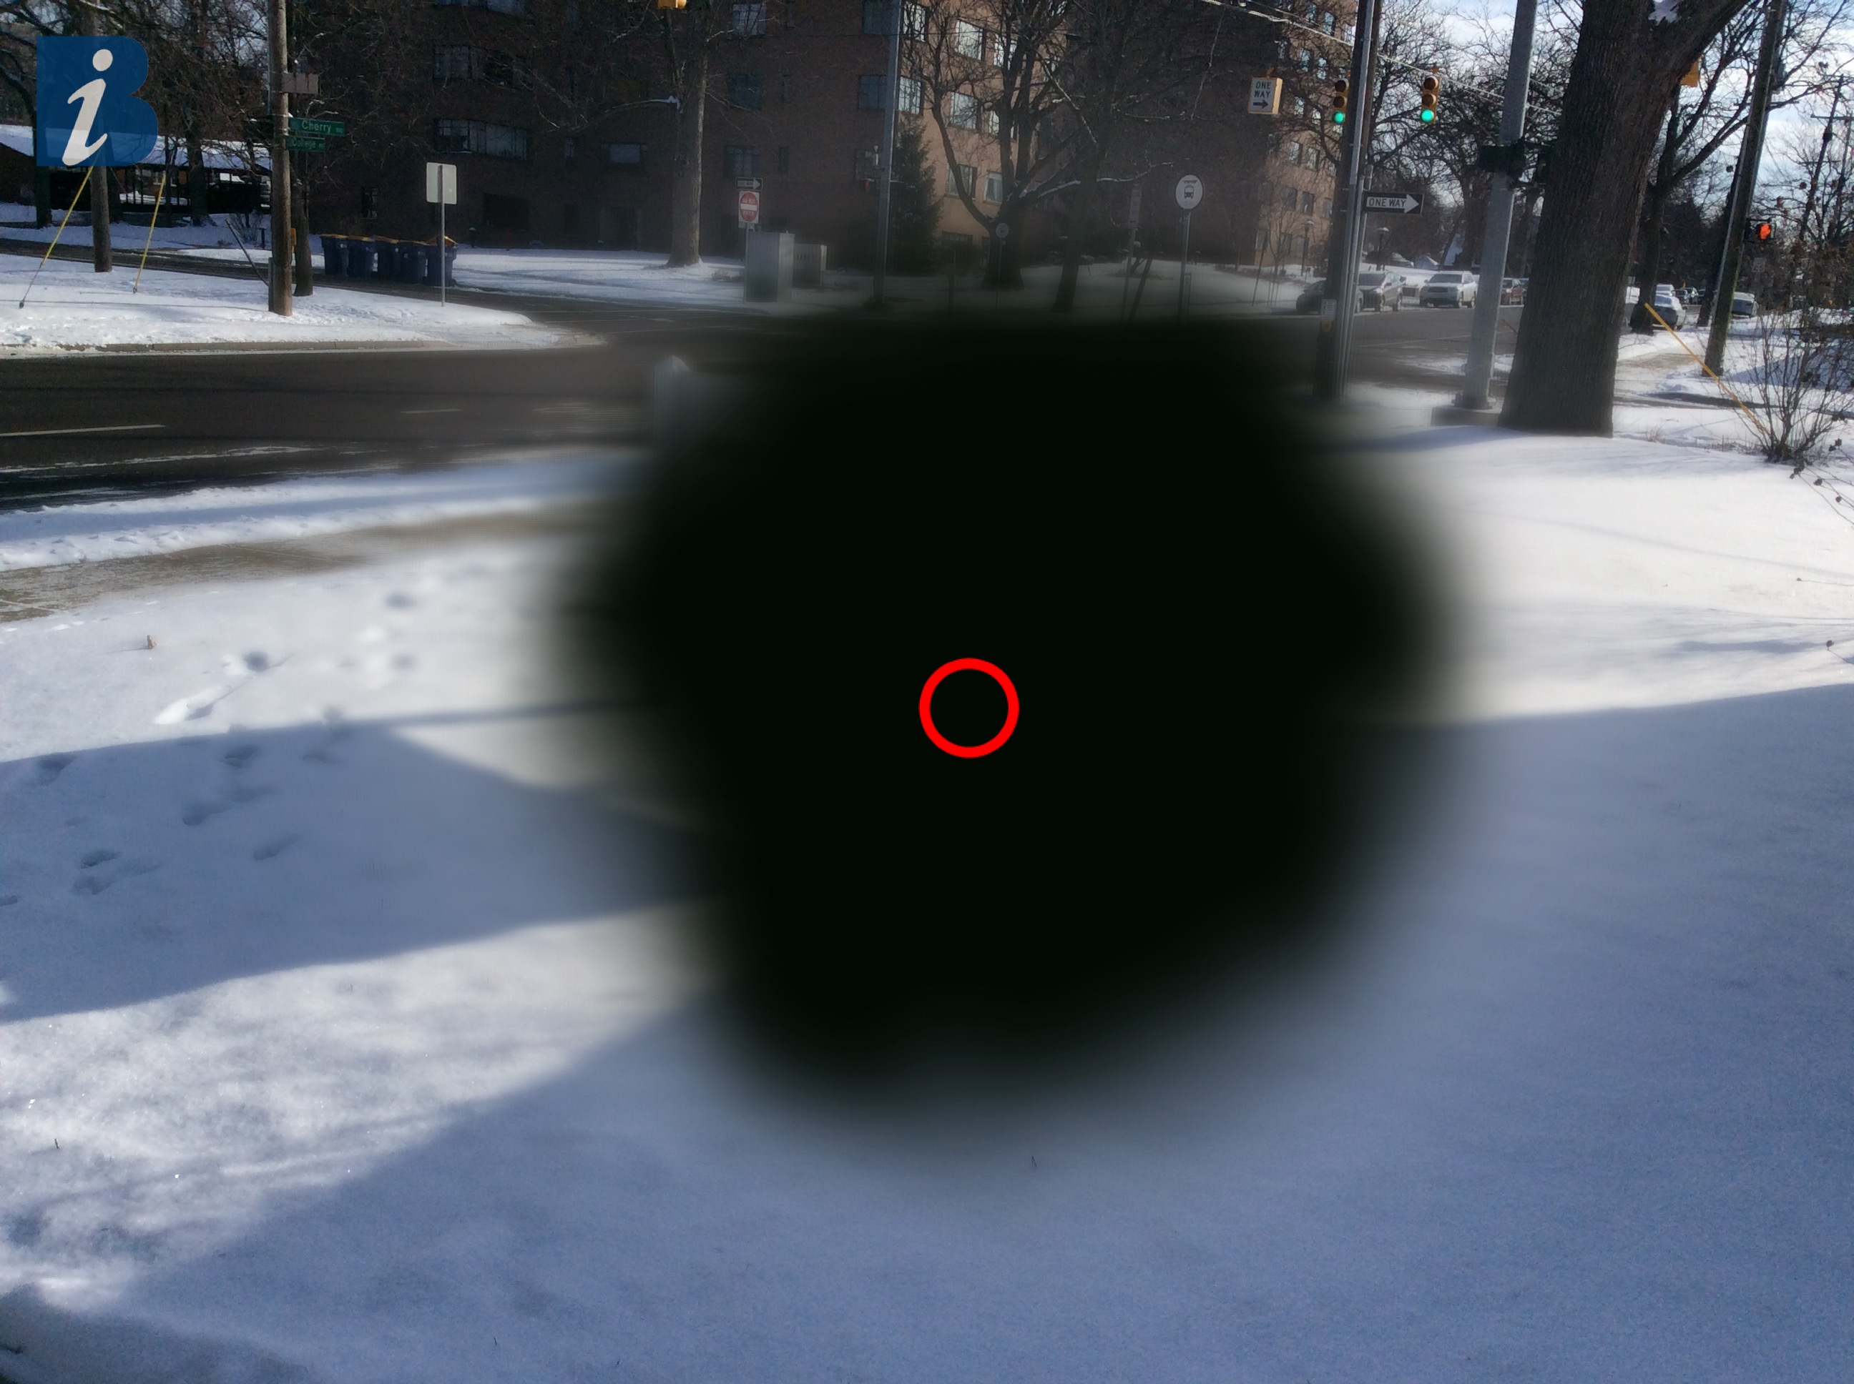

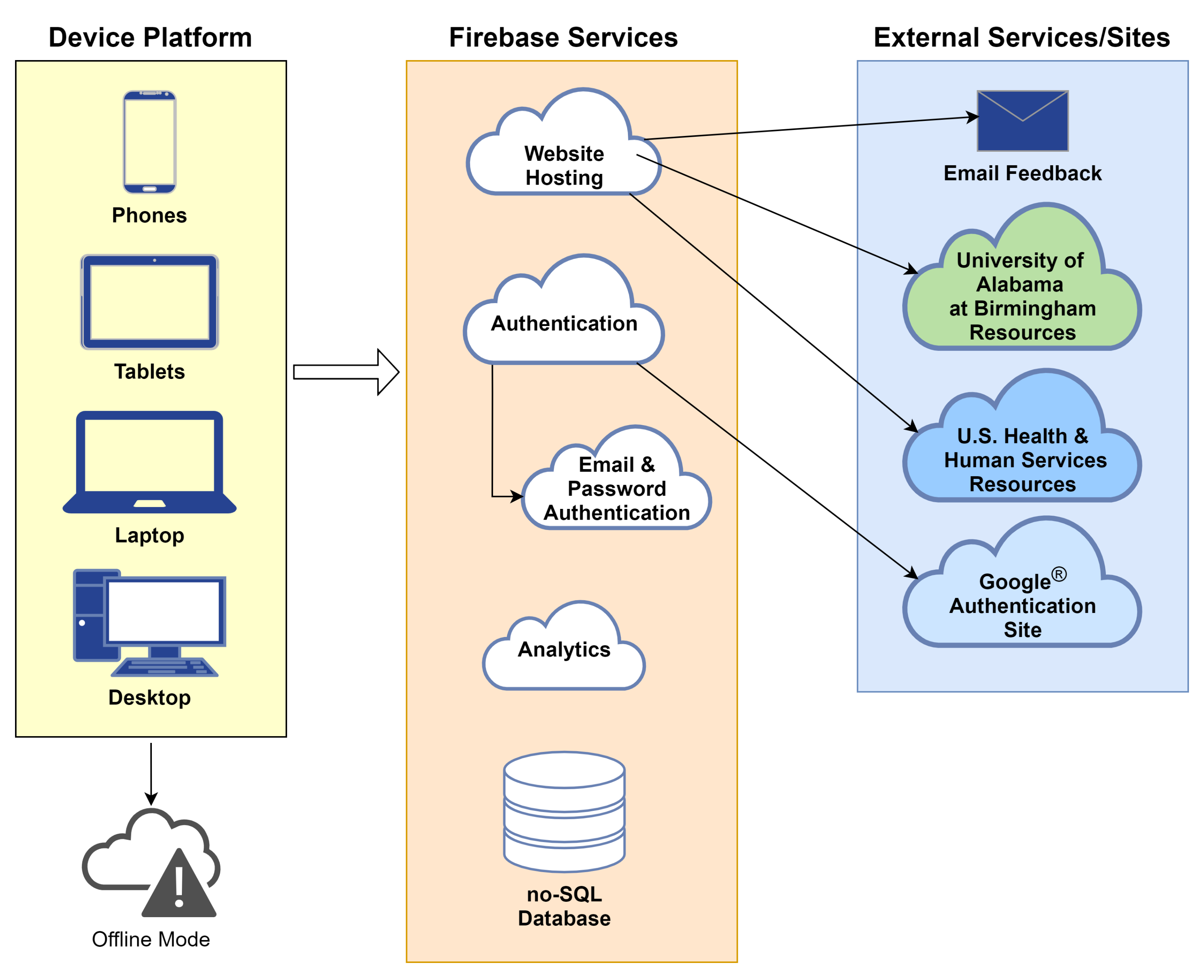
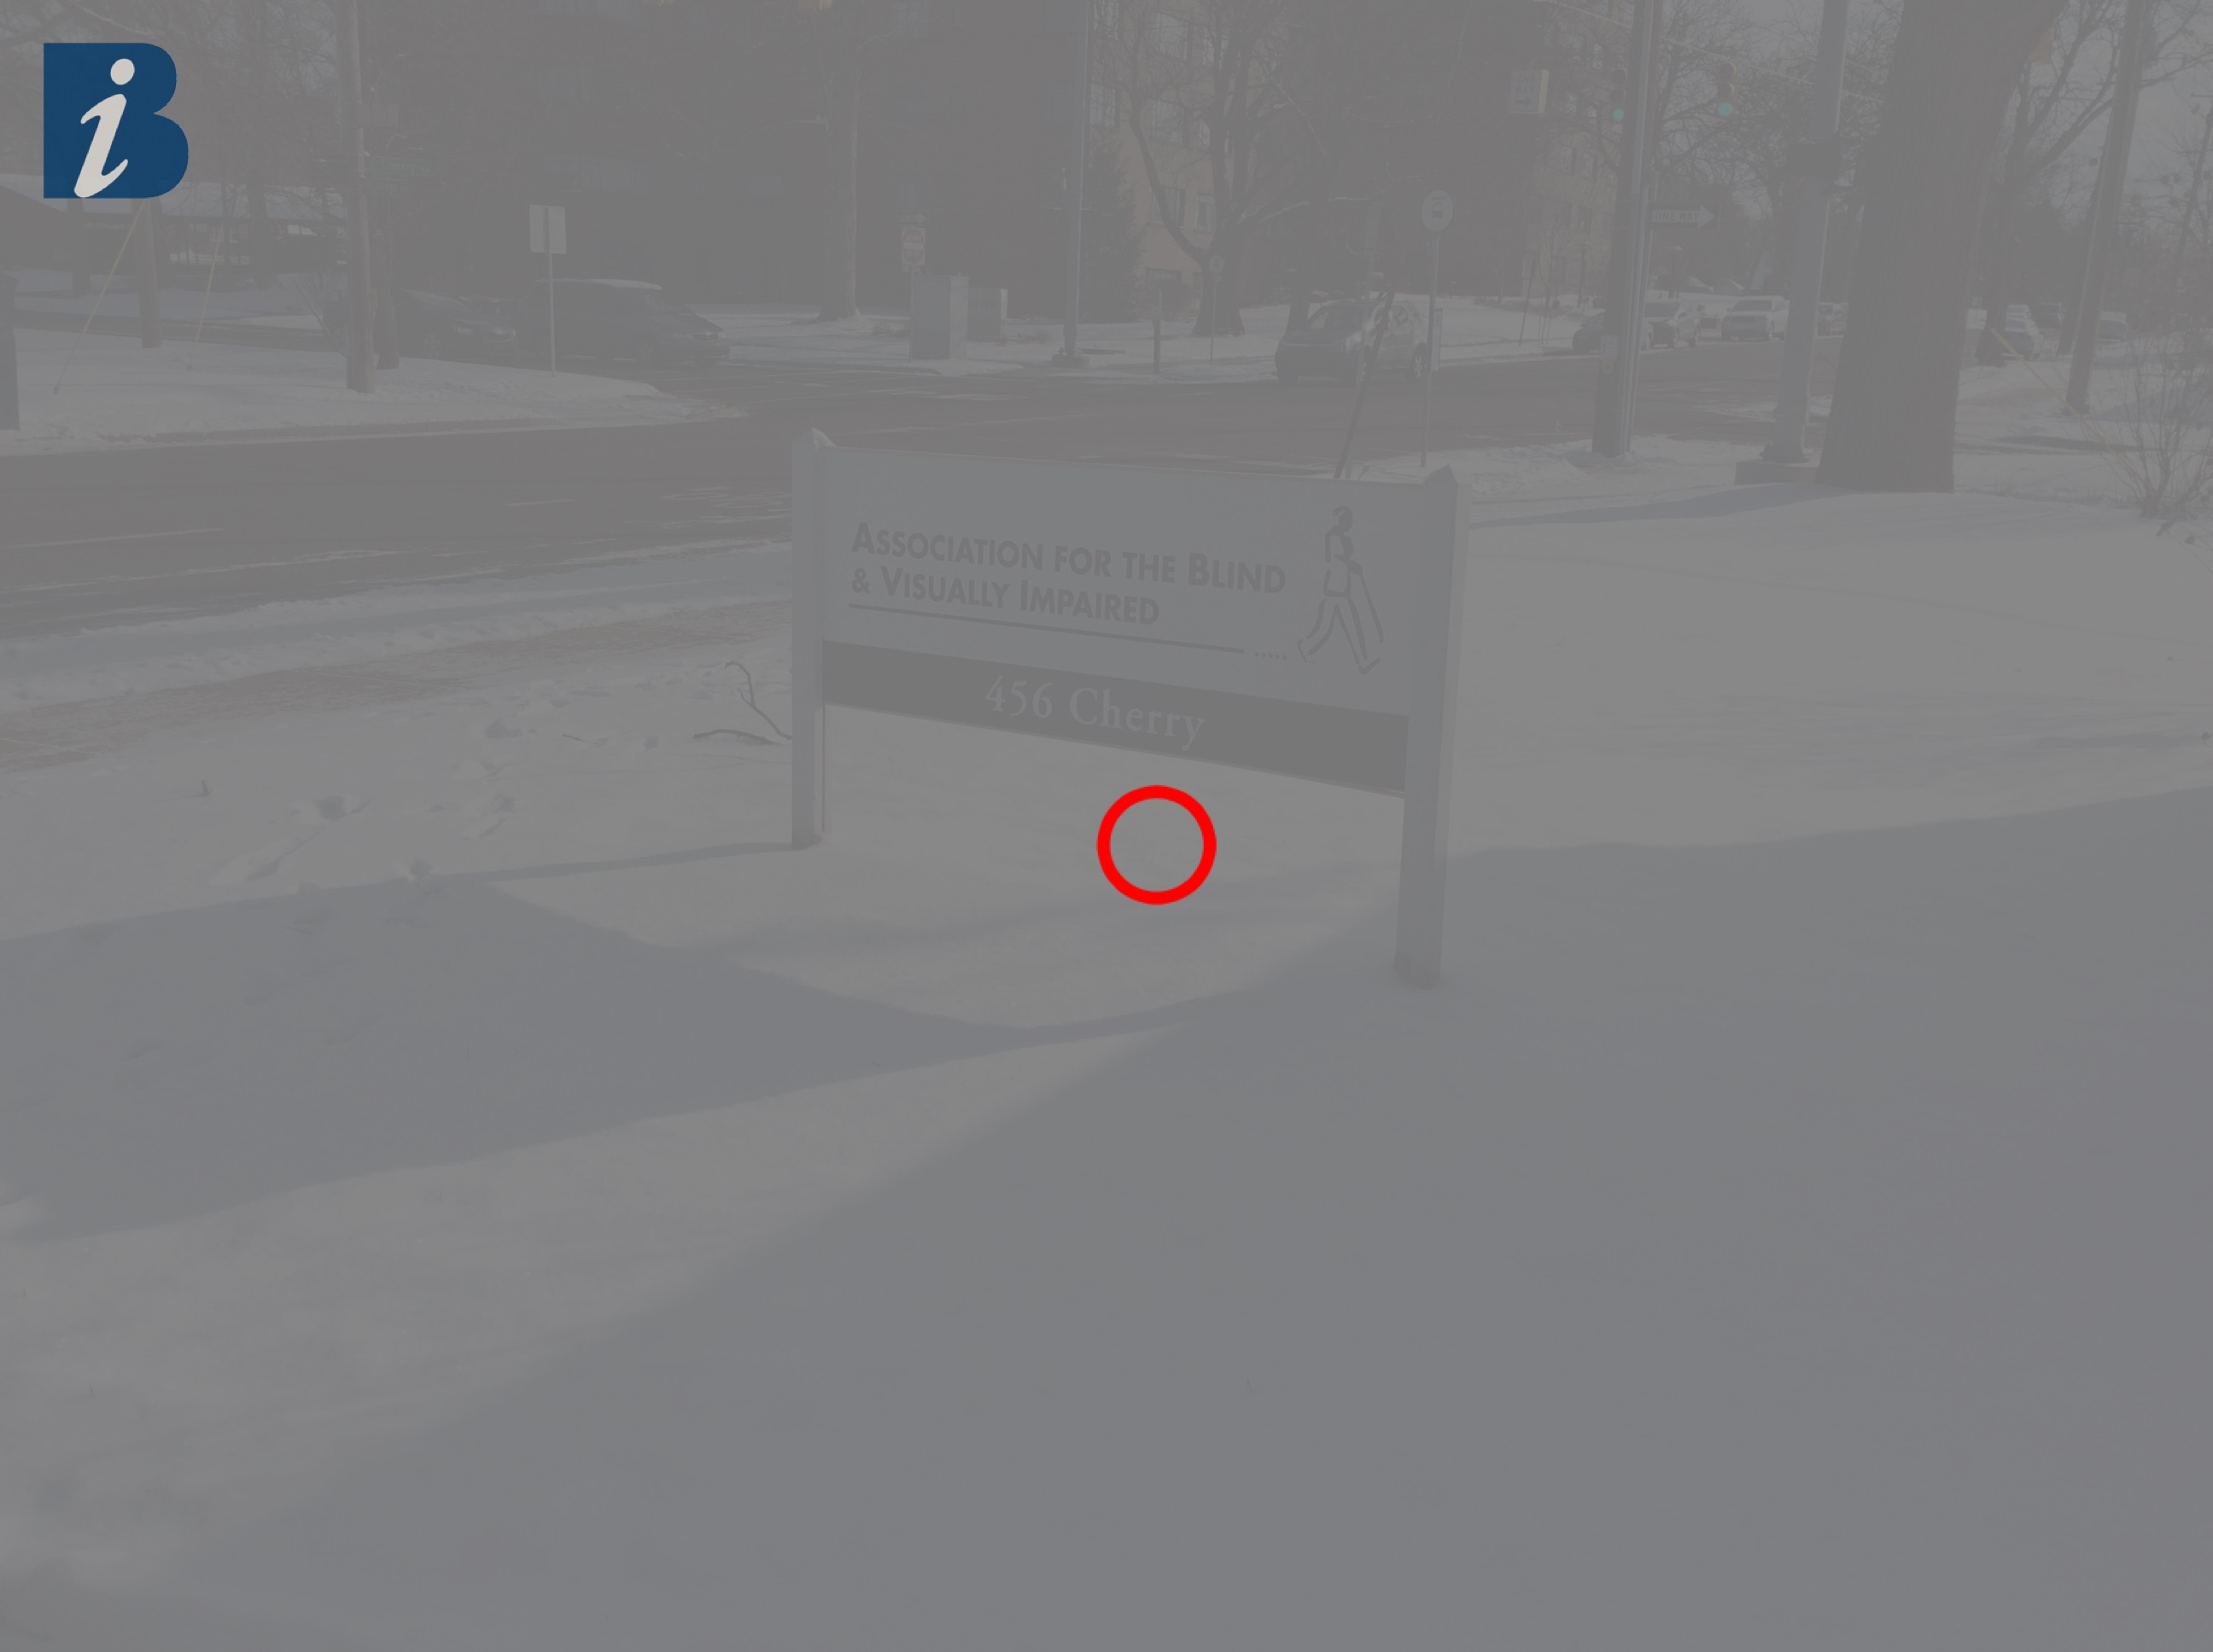
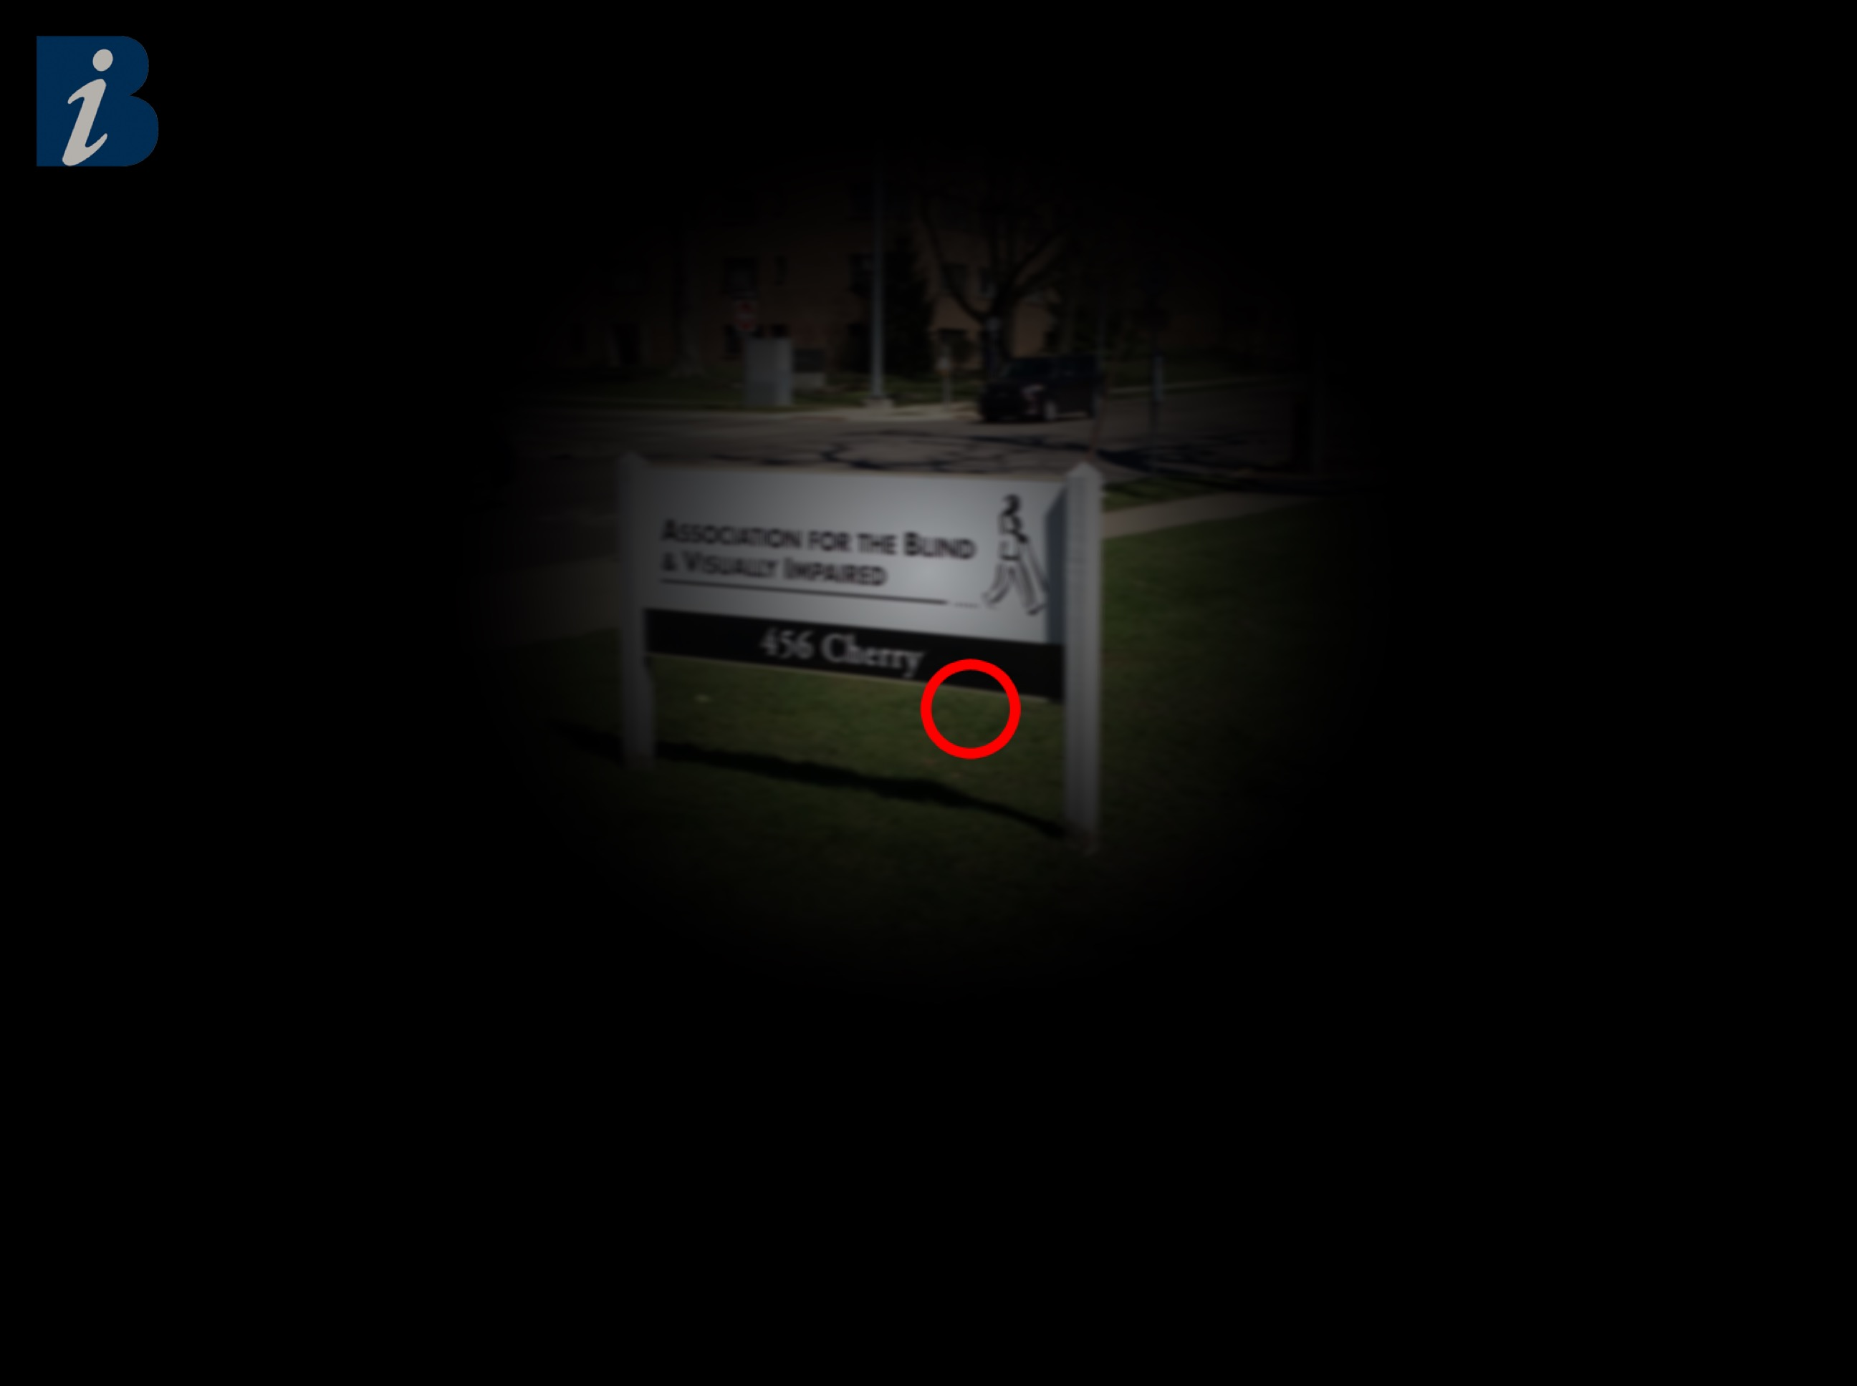
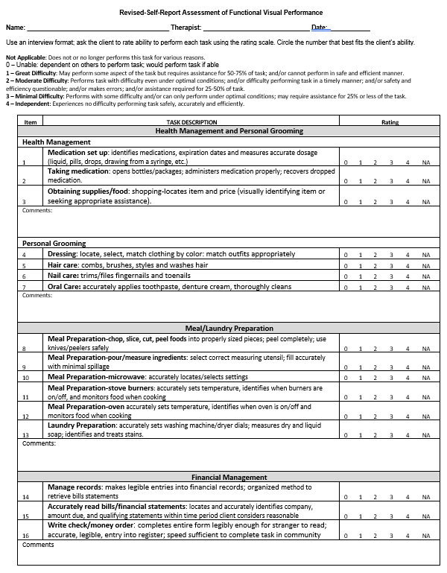
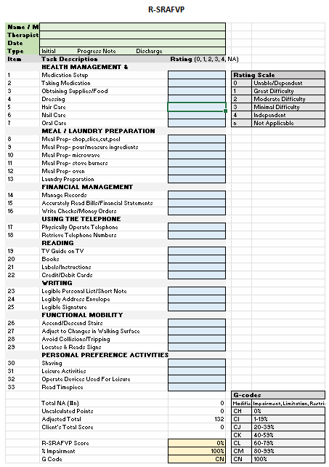
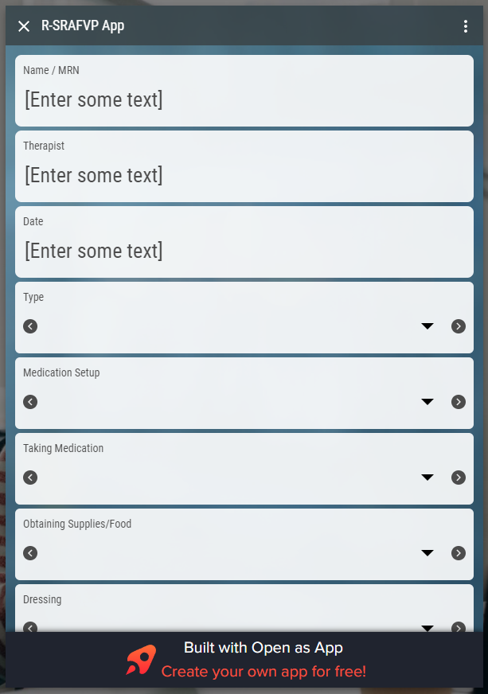
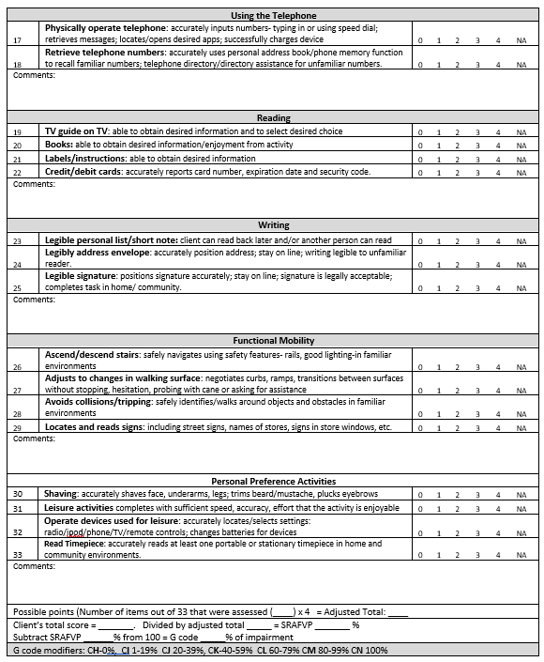
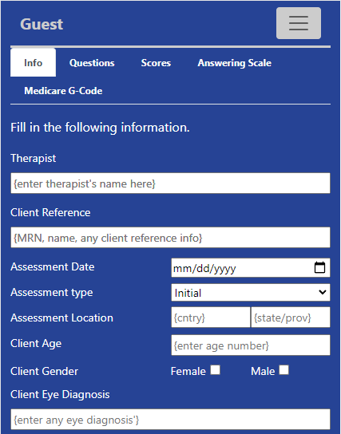
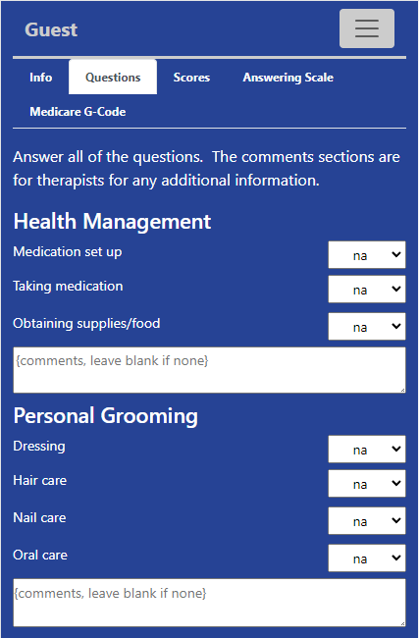
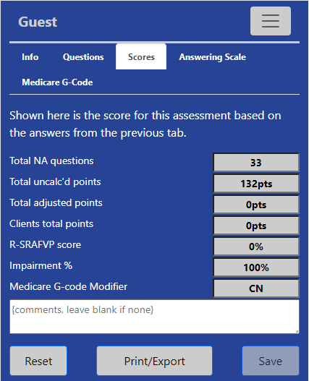
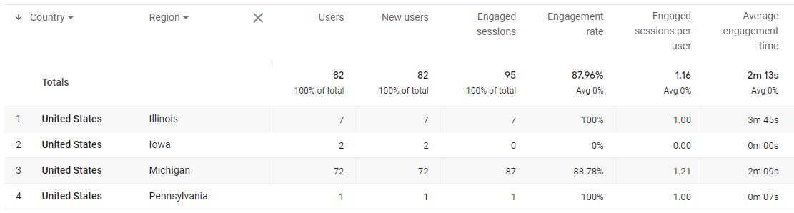
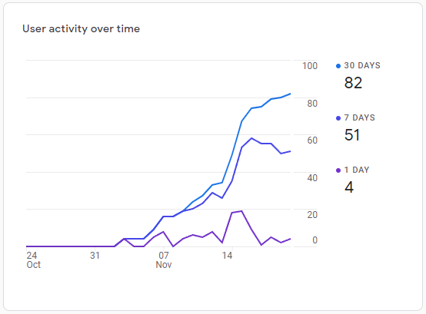
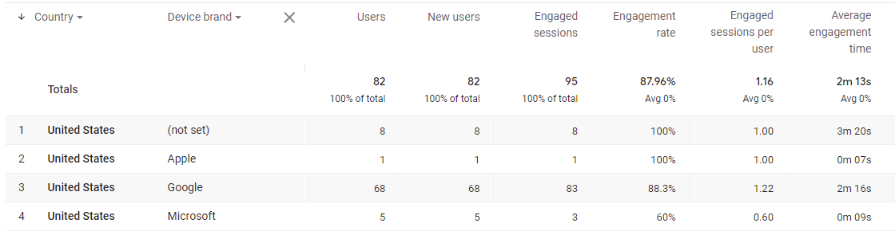
Utilizing Software Engineering and Cloud Computing Principles to Develop the
Revised Self-Report Assessment of Functional Visual Performance (R-SRAFVP) Application
Kirk Hedlich, advisor Byron DeVries (PhD)
School of Computing, Grand Valley State University, Allendale, MI 49508
Abstract
Why is this assessment important?
Architecture
Example Eye Conditions⁽¹⁾
Assessment categories⁽²⁾
Can principles from software engineering and concepts from cloud computing be applied to and aid in the development of a small project, specifically improving the use of the Revised Self-Report Assessment of Functional Visual Performance (R-SRAFVP)?
What condition does the patient have?
Health Mgmt
Reading as Activity
Age Macular Degen.
Diabetic Retinopathy
Personal
Grooming
Writing as Activity
Meal Prep
Use the Phone
How well does the patient do?
Laundry Prep
Financial Mgmt
Cataracts
Glaucoma
Personal Perference Activities
Personal Mobility / Judgement
Hedlich, Chris. “Eye Condition Examples”. 2017. JPG.
“R-SRAFVP Toolkit.” University of Alabama at Birmingham, 21 Feb. 2018. ZIP.
Goals: Improve on existing attempts Move the R-SRAFVP assessment to a PWA Provide ease of use, simplicity, greater access | Software Eng. Benefits: Engage stakeholders, Confirm requirements, Review design, Code last not first Test! Test! Test! Reduce development rework, Mitigate surprises | Cloud Computing Benefits: Reduce costs Scalable resources Reduced complexity Cross-platform flexibility Reuse instead of redevelop services Gauge usage
What are the current assessment methods?
Word processor/ PDF version⁽²⁾
Spreadsheet version⁽²⁾
R-SRAFVP App⁽³⁾
Deliverables
(3) Mohiuddin, Omar. “R-SRAFVP App.” Open as App - Instantly Open Your Data as an App, https://www.openasapp.net/portal#!/client/app/ed9f4600-e824-4447-8d3f-5a550bf5c601.
Software Engineering & Cloud Computing Usage
Software Engineering: Use Case Specification Requirements Specification Requirements Traceability Matrix UI / UX Design UI / UX Wireframe & Workflows System Architecture Design Source code Functional Tests Production Deployment | Cloud Computing: Google® Website Scalable resourcing PWA with service workers Firestore® Authentication Authentication using Email/Password Authentication using Google Accounts Firebase® Firestore DB (no-SQL) Firebase® Analytics
How does this project change the status quo?
Software Engineering Principles: Use Cases (w/ Reviews) Requirements (w/ Reviews) Requirements Traceability UI / UX Design (w/ Reviews) Development (w/ Review) Testing (functional, non-functional) Deployment Feedback / Analysis | Cloud Computing Services: On-demand services Internet accessibility Measured services Managed services Cloud Computing Technical Usage: Web hosting Progressive Web Application (PWA) Online/offline use via service workers Cloud Security Application security (authentication) Reuse of existing accounts (ex: Google) Cloud Database (no-SQL) Cloud Metrics (analysis)
www.rsrafvp.com
Outcomes / Results?
Challenges
Where are users coming from?
Healthcare compliance (U.S. HHS Security & Privacy Rules)
Development languages (HTML, CSS, Javascript)
Implementing cloud services/functionality (first time)
Platform testing (ex: Apple Mobile iOS vs anything else)
Testing at all levels (ex: unit, functional, acceptance)
Challenge of time vs. doing it right
How many users?
What types of devices are hitting the site?

